Slide 1





















Power Management
Business Management Platform

Slide 2

Table of Contents
03
What is PxM?
14
Why PxM?
16
PxM Evolution
18
Architecture Overview
21
Microsoft Licenses
24
Target Customer Segments
26
Strategies to Identify Leads
28
Partner
with PxM
02

Slide 3

What is PxM?
A next-generation, modular, AI-powered Business Management Suite
built on Microsoft Power Platform
03

Slide 4


















Power
Management
Your 360 Business Management Suite Powered by Microsoft Power Platform
04

Slide 5


























Benefit Management
Strategy Management
Measure, validate, and realize
initiative benefits.
Define strategic objectives and KPIs
and align enterprise initiatives.
Performance Management
Demand Management
Track KPIs and monitor strategic
progress.
Capture, align, and approve
demand.
Resource Management
Portfolio Management
Optimize capacity and allocate
workforce effectively.
Evaluate, prioritize, and select
optimal portfolios.
Project Management
Program Management
Plan, execute, and govern project
delivery from initiation to closure.
Coordinate projects and manage
program outcomes.
05

Slide 6



Strategy Management
Explore the module online
Visit website
Shape Direction with Strategic Clarity
Integrated line of sight across strategic lifecycle
Balanced Scorecard-based design
Define strategies and cascade them through perspectives, objectives, and KPIs with configurable weights to reflect organizational priorities.
Projects
Map demands, portfolios, initiatives, programs, and projects directly to strategic objectives and KPIs and realize benefits.
Portfolios
Performance
STRATEGIES
Demand
PILLARS
Benefits
Enterprise-wide strategy cascade
Propagate strategic goals across departments, programs, and delivery teams for consistent alignment.
Strategy aligned and value driven decision making
OBJECTIVES
Prioritize investments and efforts based on measurable contribution to strategy.
KPIs
06
...
DEPARTMENT
DEPARTMENT
DEPARTMENT
...

Slide 7


Demand Management
Explore the module online
Visit website
Prioritize the Right Opportunities
End-to-End Ideation and Demand Intake
Capture ideas and business cases across all levels of maturity.
Demand Intake
Unified Demand Funnel
Integrate scattered demand sources coming from different enterprise systems and unify them all under one demand pipeline.
Business Case Development
Automated Governance Through Approval Workflows
Apply transparent, role-based workflows to ensure governance, compliance, accountability, and traceability.
Evaluation and Prioritizing
Structured Assessment & Prioritization
Evaluate each demand against weighted business drivers, benefit mapping, financial viability, and resource feasibility.
Portfolio Roadmapping
Strategy-Aligned Demand Progression
Advance only strategically aligned, high-value, or essential compliance initiatives.
Investment-Ready Pipeline Creation
Produce a refined pipeline that flows directly into portfolio analysis and supports informed decision-making.
07

Slide 8



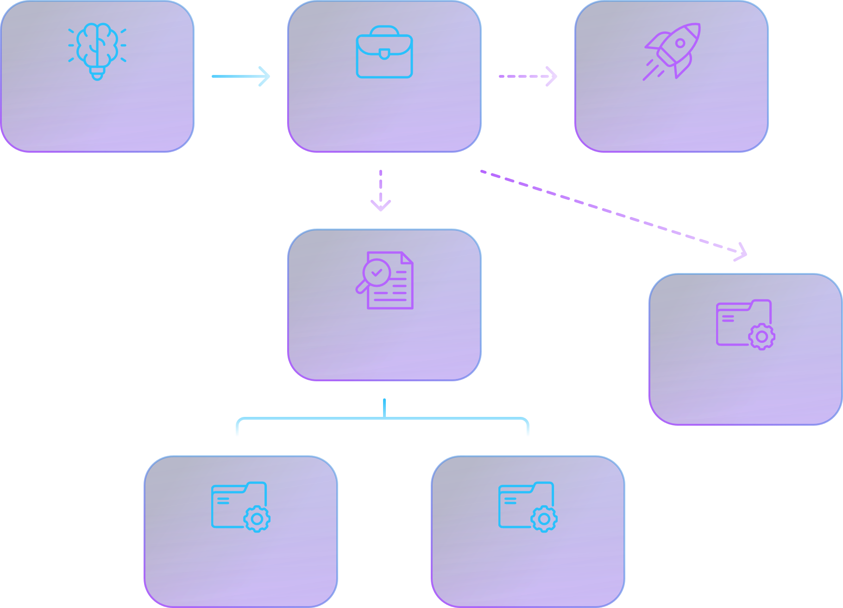
Portfolio Management
Explore the module online
Visit website
Invest in the Right Initiatives, Every Time
Portfolio Prioritization
Prioritizes initiatives across value, financial impact, and resource feasibility, enabling confident portfolio-level decision-making.
Idea
Demand
Initiative
Initiative Structuring
Structures ideas and demands into governed initiatives, creating a clear bridge between strategic intent and executable work.
Execution Traceability
Program
Convert demand into initiatives, programs, projects, and change requests ensuring traceability, execution readiness, and portfolio governance.
Project
Portfolio Roadmapping
Deliver a dynamic portfolio roadmap, visualizing initiative sequencing, dependencies, and investment impact over time.
Project
Project
08

Slide 9


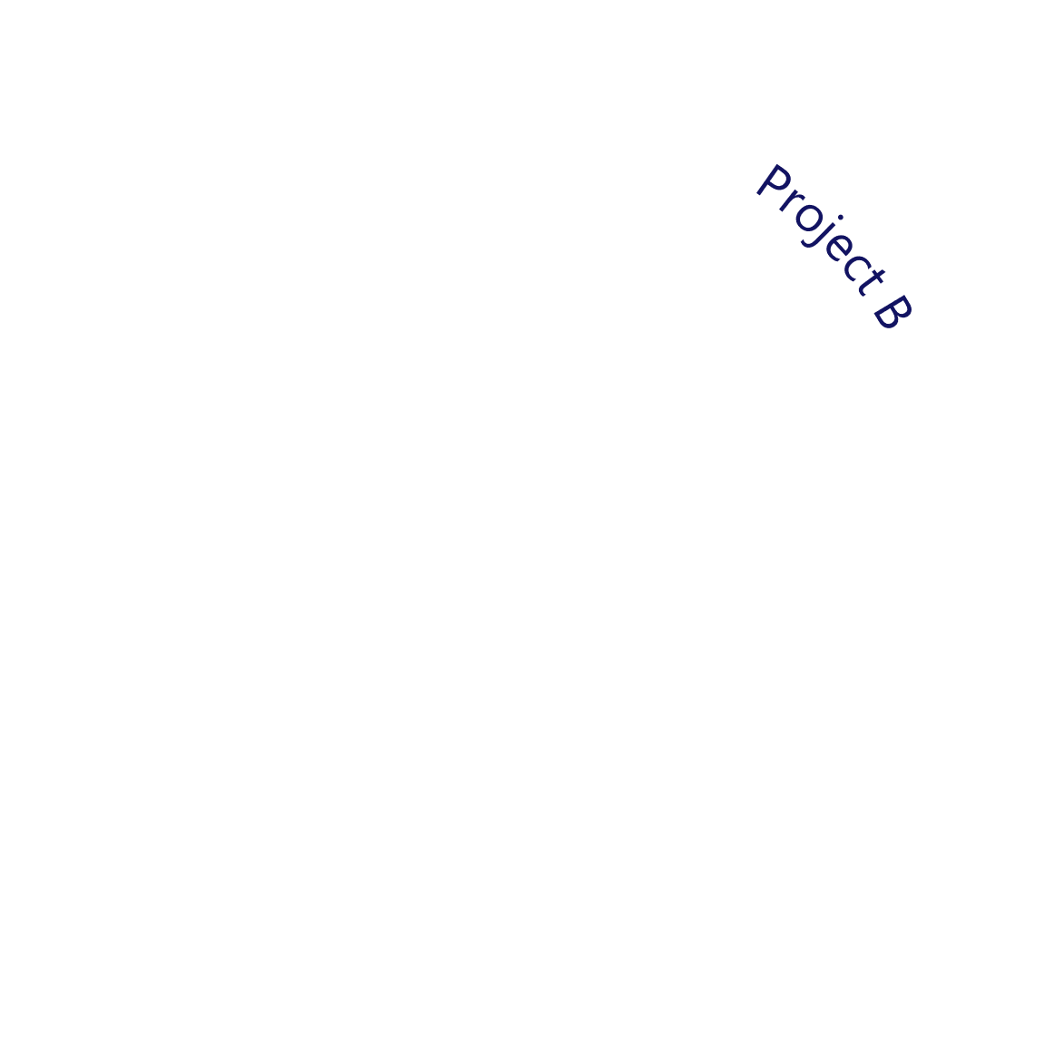



Program Management
Explore the module online
Visit website
Unify program delivery into one intelligent framework
Strategic Integration across Portfolio Projects
Risks
Structure multiple projects into coherent programs that advance shared strategic outcomes.
Program
Milestones
Cross-Project Governance & Dependency Control
Manage interdependencies, consolidated risks, issues, and milestone alignment in a single governed environment.
Financials
Real-Time Program Performance Insight
Monitor financials, schedules, benefits, and delivery progress holistically to support informed decision-making.
Benefits
09

Slide 10


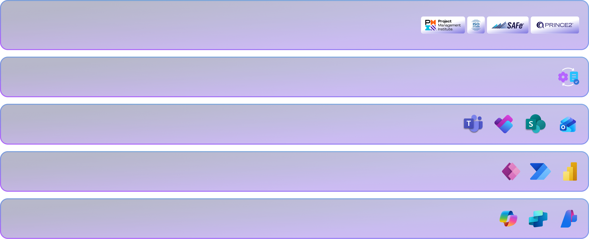
Project Management
Explore the module online
Visit website
Bring your projects to life with intelligent execution
Govern projects from inception to value with turnkey processes based on PMO industry leading practices
and work class reference models.
Aligned with PMO Industry-Leading Practices
Business Case → Demand
Carry forward strategic alignment, benefits, and financials from demand into execution.
Integrated Collaboration Across Microsoft 365
Unite tasks, communication, documents, and approvals across Teams, Planner, SharePoint, and Outlook.
Comprehensive Governance & Control
Manage risks, issues, dependencies, deliverables, and changes in one governed workspace.
AI-Enhanced Execution & Organizational Learning
Summarize insights, predict risks, and accelerate delivery with intelligence powered by your organization’s data.
10

Slide 11






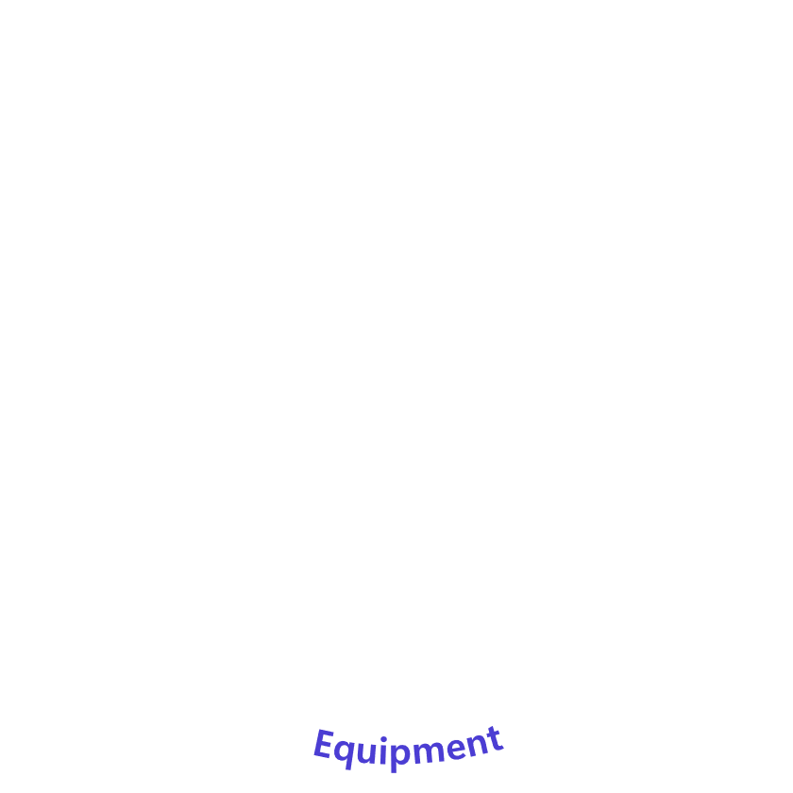

Resource Management
Explore the module online
Visit website
Unlock the full potential across every resource
Enhanced Resource Scheduling
AI-Optimized Resource Allocation
Leverage enterprise-grade scheduling capabilities to model and manage all resource types across people, assets, and investments.
Recommend best-fit resources for tasks based on skills, workload, and historical performance.
Unified
Resource
Management
Unified Resource & Skills Intelligence
Capacity Simulation & Scenario Modeling
Consolidate roles, skills, availability, and capacity into a unified, dynamic resource inventory used across PxM.
Identify shortages, simulate hiring scenarios, and evaluate feasibility across multiple planning horizons.
13

Slide 12






Performance Management
Explore the module online
Visit website
Strengthen your performance and celebrate your wins!
Integrated Line of Sight
from Strategy to Outcomes
Connect strategic objectives to delivery performance and realized value.
Continuous
Performance
Improvement
Enterprise KPI Governance
with Cascaded Accountability
Track strategic organizational KPIs across departmental and team levels.
12

Slide 13


Benefit Management
Explore the module online
Visit website
Translate commitments into tangible achievements
Formulate / Refresh Strategy
Review
Prioritization
Model
Adapt to
Change
Monitor & Control
Deliver
Business
Outcomes
Ideate & Collect Demand
Structured Definition of Benefits
from the Start
Automated Benefit Tracking
& Owner Engagement
Communicate, Execute,
& Report
Capture qualitative and quantitative benefits with baselines, targets, owners, and timelines.
Prioritize Demand
Automate the timely collection, review and approval of benefits and trend their impact on strategic objectives.
Analyze Portfolios
Seamless Flow from Business
Case to Realization
Real-Time Visibility
into Performance
Carry benefits into delivery and link them to strategic KPIs for traceability.
Monitor trends through dashboards to validate assumptions, course-correct early, and confirm ROI.
11

Slide 14

Why PxM?
From Fragmented Processes to Connected Intelligence
14

Slide 15

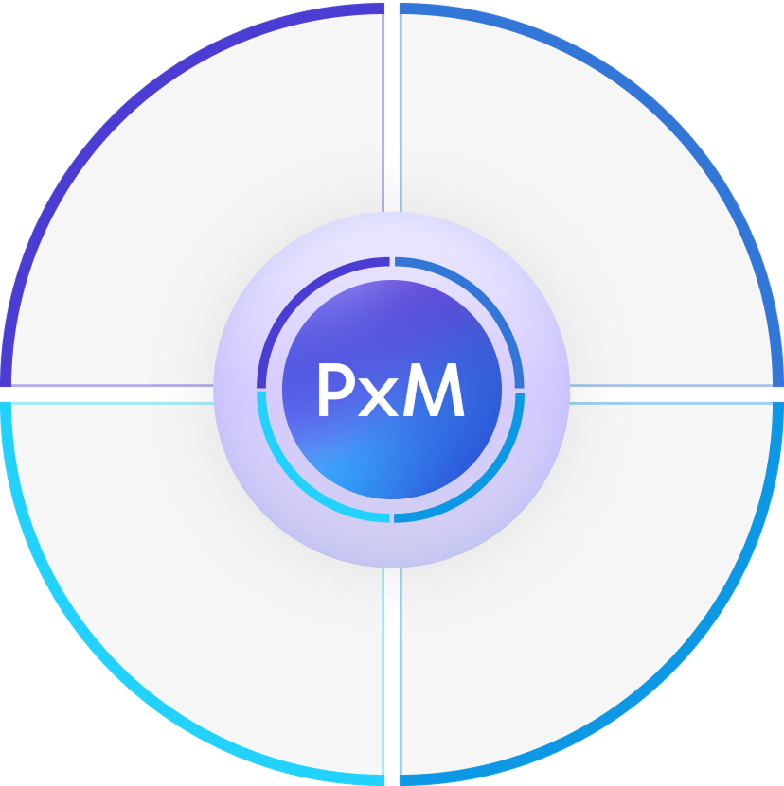











Digital Governance
Microsoft Cloud
Unified governance incorporating world class reference
models and methodologies across strategy formulation,
roadmap planning, portfolio execution and corporate
performance.
Seamlessly integrates Microsoft 365 collaboration tools,
Dynamics 365 business applications, and the broader
Microsoft cloud and Azure ecosystem, harnessing the
power of AI with Copilot— all in a single connected
platform.
Industry-scale Solution
AppSource Ready
Designed for Strategy & Transformation Offices across
diverse industries, ranging from Government to
Enterprise and Industry-scale STOs, and covering
various disciplines in SPM, PMO, GRC and more.
Packaged as a GA solution on MS AppSource for
customers, partners, CSPs, and implementation teams.
Available in multiple license schemes covering a wide
range of use cases and enabling low-code customization,
powerful automation, and real-time analytics on top of
Power Platform.
15

Slide 16

PxM Evolution
From On-Premise to AI-Driven Future
16

Slide 17

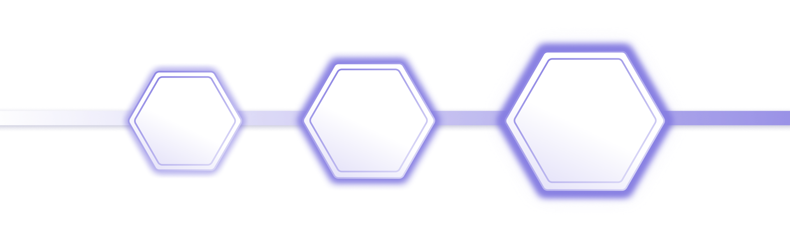
Cloud-based Power Platform solution
Seamlessly integrated with M365 ecosystem
Retained and amplified SP3M Execution Strengths
+ Introduced Strategy Planning and
Strategy Performance Management
2024 – Present
Next Generation
SP3M
PxM
2016 – 2023
On-premise PMO solution built
on SharePoint & Project Server 2019
A robust foundation in execution, governance, and digital delivery
Future
Integrating deeper with Dynamics
365 apps and Copilot Studio
PxM Service Management
PxM GRC
PxM EA
17

Slide 18

Architecture Overview
How PxM Integrates with Microsoft Cloud
18

Slide 19










Built on
Power Platform
A unified Low code/No code digital
foundation across data, automation,
analytics, and AI
Power Pages
Power Virtual Agents
Dataverse
External-facing websites
Intelligent chat conversation
Secure data repository
Power Apps
Power Automate
Copilot Studio
Power BI
App development
Process automation
Conversational AI building
Business analytics
19

Slide 20



















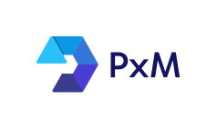




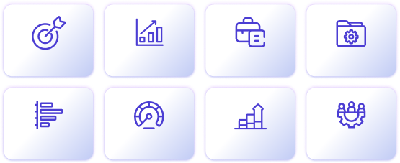
















Security & compliance
Productivity Tools
Project Sources
LOB Systems
Smartsheet
Azure Devops
Jira
Project
Servicenow
Copilot
Outlook App
Fusion
Microsoft Defender
Primavera
Planview
Asana
Planisware
Planner
Jaggaer
Office 365
Teams App
Microsoft sentinel
D365 PO
Loop
Approvals
Strategy
Demand
Portfolios
Programs
D365 CE
Microsoft Purview
Viva
SharePoint
Projects
Performance
Benefits
Resources
D365 FO
Power Platform
Aris
Microsoft Security Copilot
Power Apps
Power Pages
Power Automate
Power Virtual
Agents
Copilot Studio
Dataverse
Power BI
SAP
20

Slide 21

Microsoft Licenses
Overview of Microsoft Licenses for PxM
21

Slide 22














Copilot
Planner
P1 / P3
Power Apps
Premium
Teams
Office 365
E3 / E5
Power BI
Pro
22

Slide 23











Microsoft licenses required per PxM license
for (Personas)
License
0365
E3/E5
Teams
Enterprise
Planner
P1
Planner
P3
M365
Copilot
Power Apps
Premium
Power BI
Pro
Demand Owners
Strategy Officers
PMOs
P1
PxM - Demand Management
P2
PMOS
Projects Stakeholders
Project Managers
Team members
P1
PxM - Portfolio & Project Management
P2
Strategy Officers
Corporate Performance
Senior Leadership
Organization Units
P1
PxM - Strategy Performance Management
P2
Strategy Officers
PMOS
PxM Premium
P1
23

Slide 24

Target Customer Segments
Identifying Opportunities Based on Industry Needs
24

Slide 25









Government
Technology
Strategic initiatives, national
programs, digital PMOs
Product Lifecycle and Release
Management, DevSecOps, SAFE
Target Customer Segments
Enterprise & Corporate
Construction
Portfolio governance, performance
optimization
Capital projects, cost control,
contract management
Education & Research
Insurance & Financial Services
Grant and innovation lifecycle
management
Risk mitigation, regulatory
program tracking
Healthcare
Compliance-driven projects,
quality improvement
25

Slide 26

Strategies
to Identify Leads
Unlocking high-value, targeted engagement
26

Slide 27

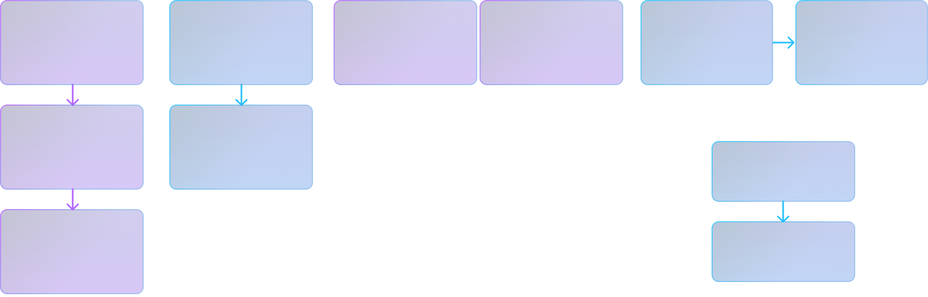
Project/
Planner Licenses
Customer with active licenses for:
Project/Project server
Project Online
Project for the web
Planner​
Strategy/
PM Office
Customers with strategy and
PMO offices in different
formations.
Strategy &
Transformation
Office
Strategy &
Transformation
Office
Strategy & Corporate
Performance
(E)PMO
Centralized vs Decentralized
Controlling vs Directive
EPMO
IT PMO
or
Strategy Execution
(E)PMO
Centralized vs Decentralized
Controlling vs Directive
EPMO
(E)PMO
EPMO
Centralized vs Decentralized
Controlling vs Directive
27

Slide 28

Partner with PxM
Driving mutual value through Strategic Collaboration
28

Slide 29









Co-sell readiness with
enhanced marketplace
visibility and tailored
discounted offers.
Joint GTM campaigns such as
partner presales support and
co-delivered demos.
Distributor collaboration for
partner training and enablement.
FastTrack delivery support
program.
PxM
Partner Program
29

Slide 30












Thank you.
Email
Phone
Website
contact.pxm@vn3xt.com
971-52-669-6648
pxm.vn3xt.com

